Slide 1
Recommender
For latex

Slide 2
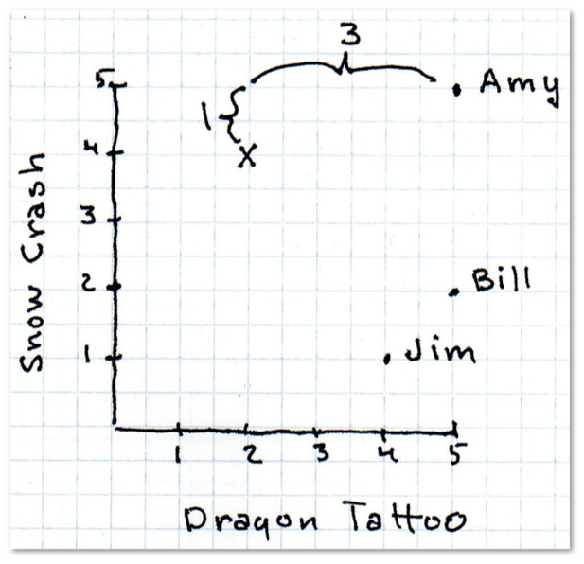
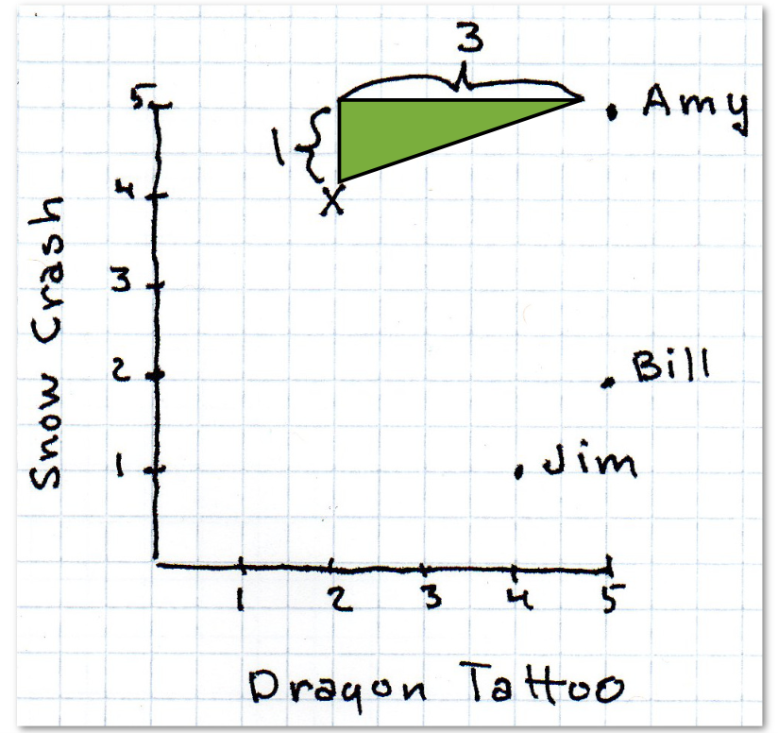

Slide 3
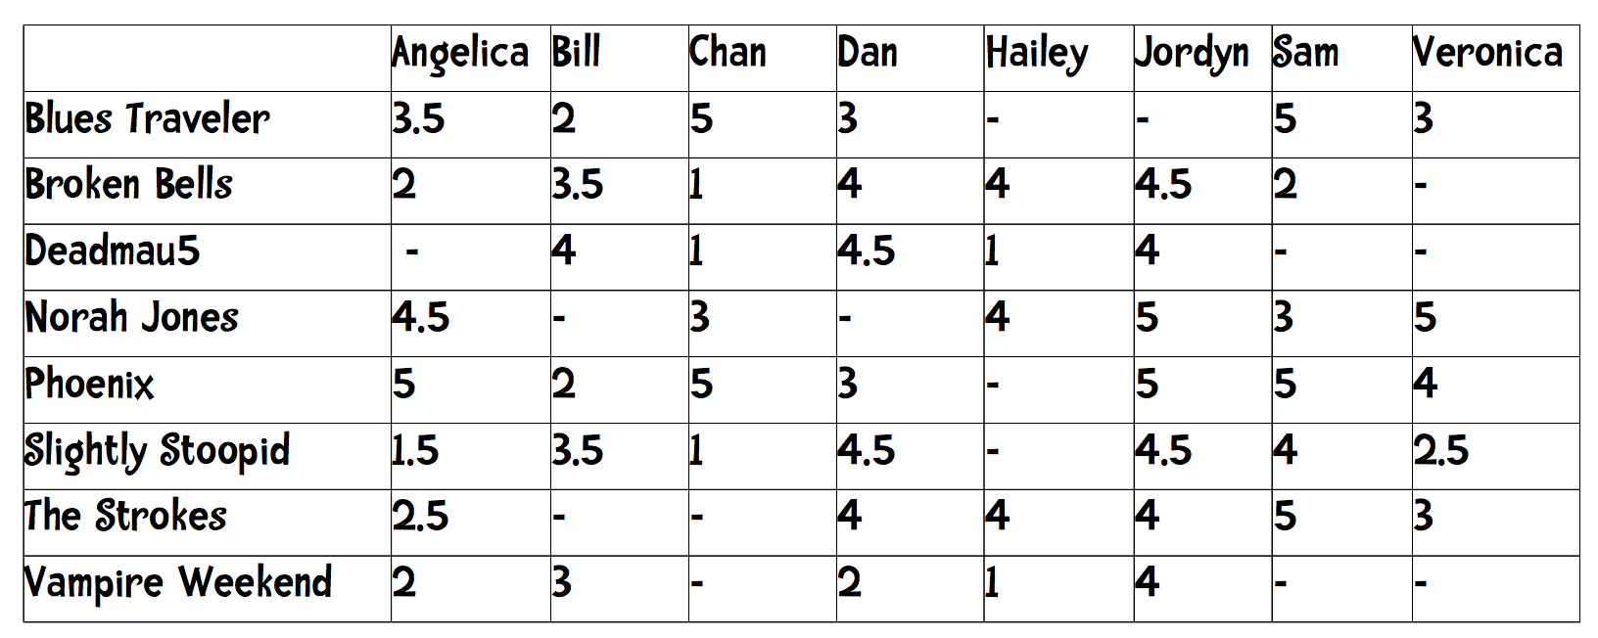
N-dimensional

Slide 4
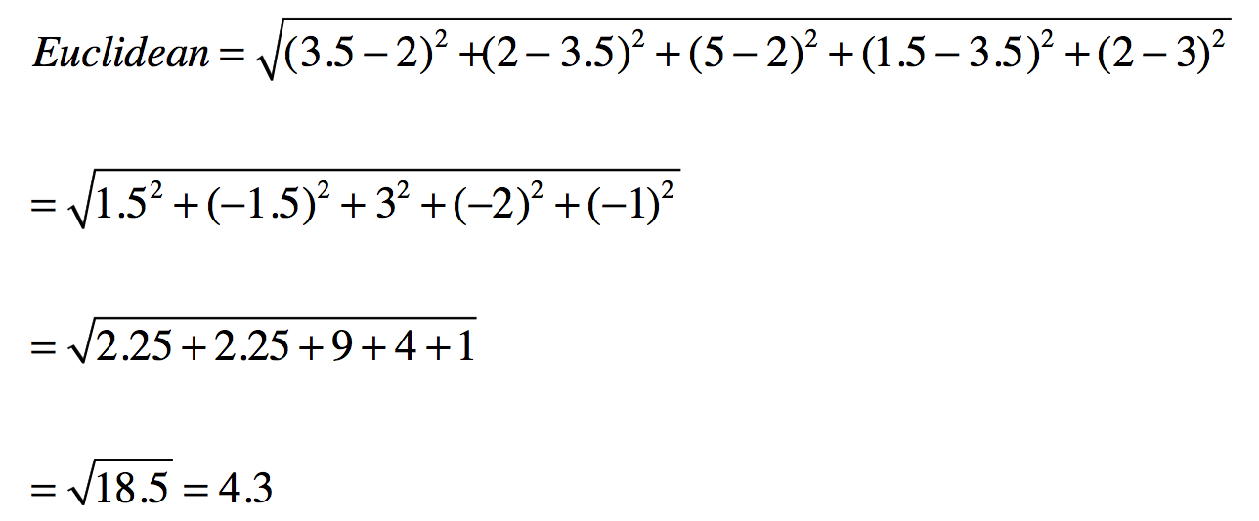

Slide 5
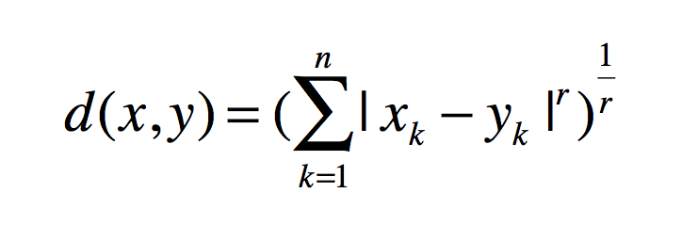
A generalization
Minkowski Distance Metric
r = 1: The formula is Manhattan Distance.
r = 2: The formula is Euclidean Distance
r = ∞: Supremum Distance

Slide 6
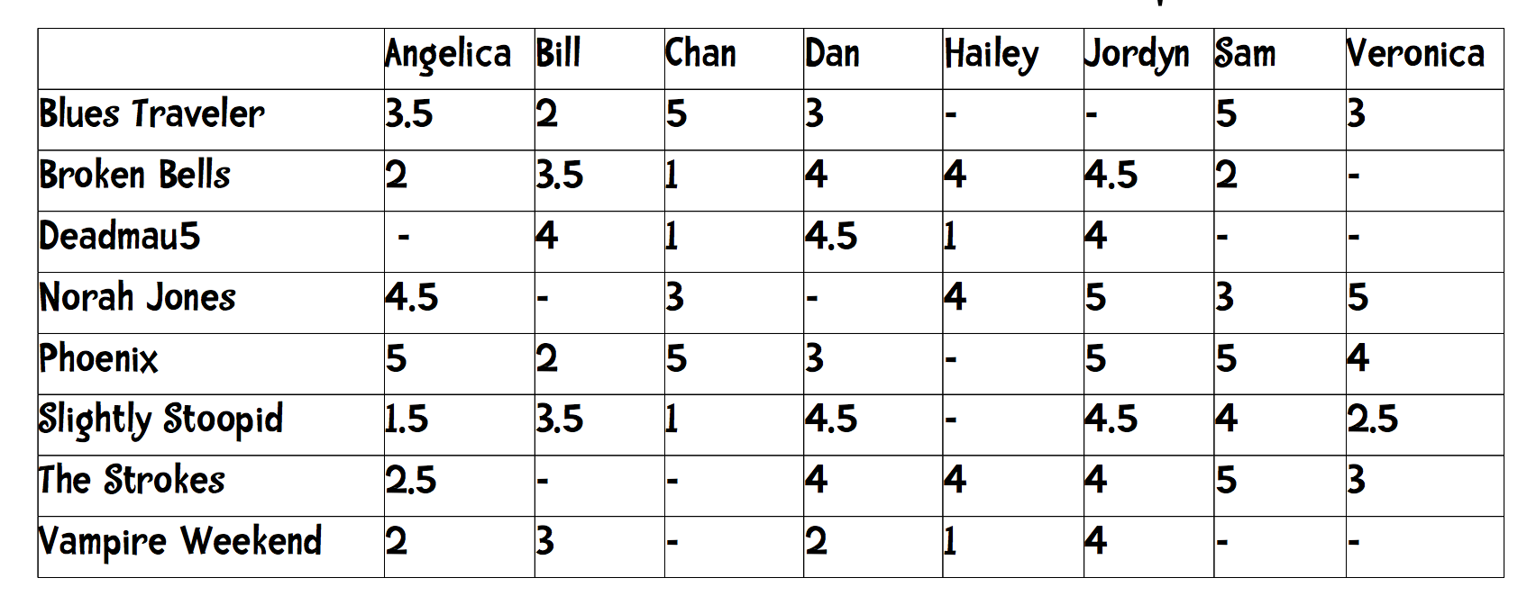
What is the problem?

Slide 7
Bill seems to avoid the extremes. His ratings range from 2 to 4
Jordyn seems to like everthing. Her ratings range from 4 to 5.
Hailey is a binary person giving either 1s or 4s to bands.

Slide 8
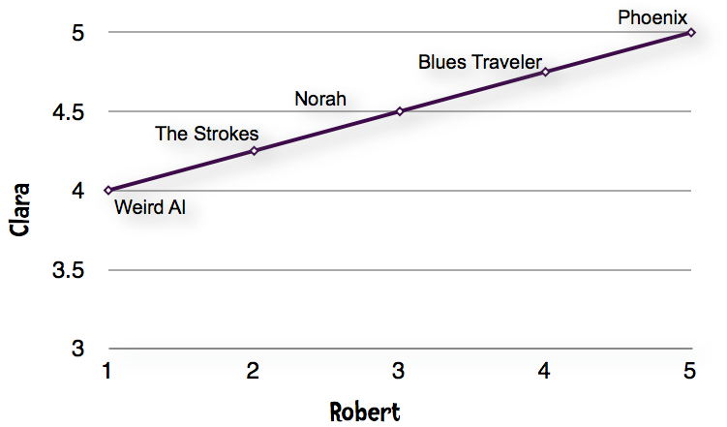
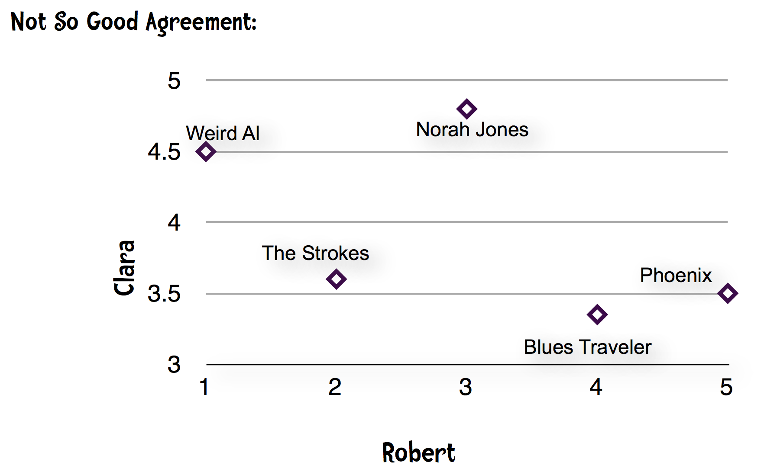
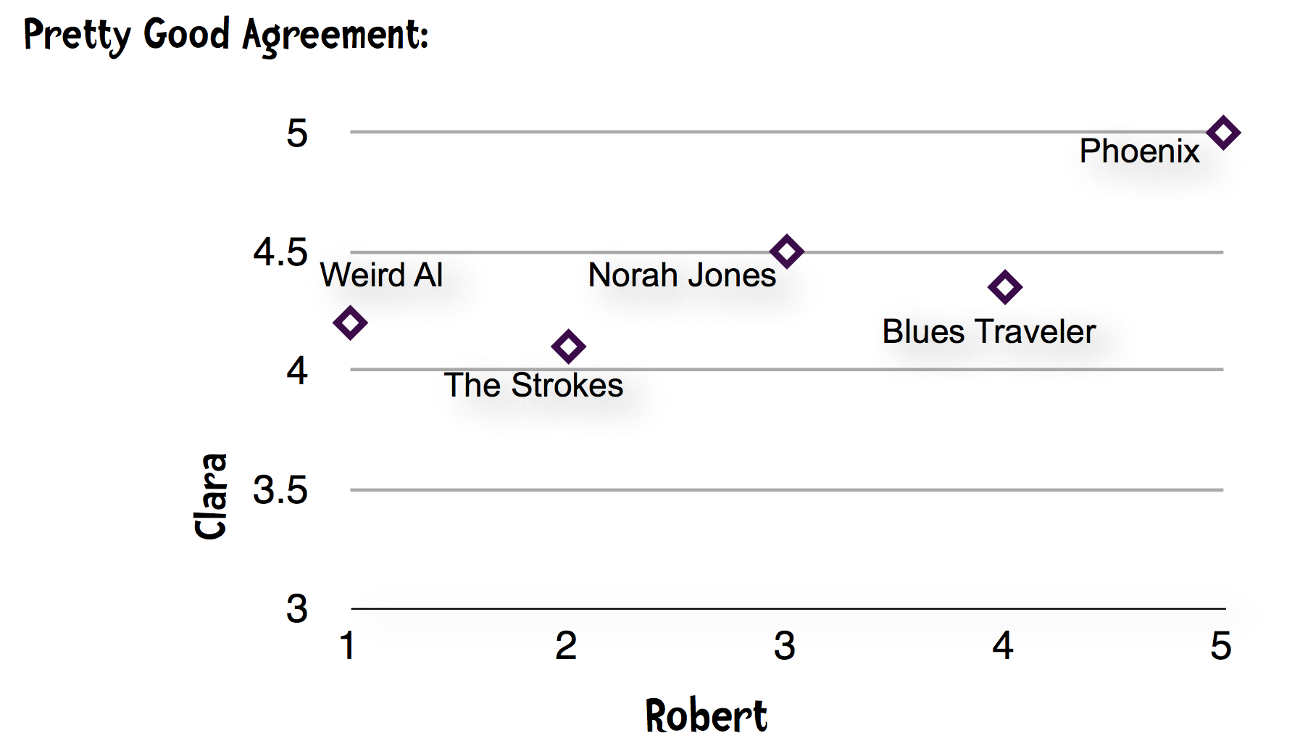
Perfect agreement

Slide 9
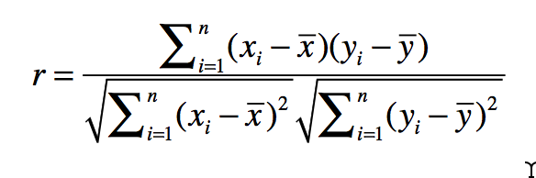
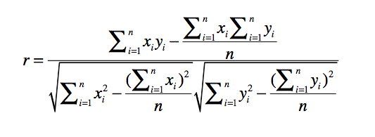
Pearson Correlation Coefficient
It ranges between -1 and 1 inclusive.
1 indicates perfect agreement.
-1 indicates perfect disagreement.
Approximation of Pearson

Slide 10
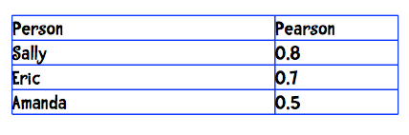
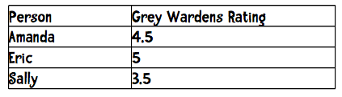
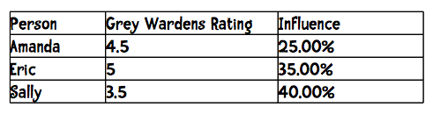
K-nearest

Slide 12



Slide 13
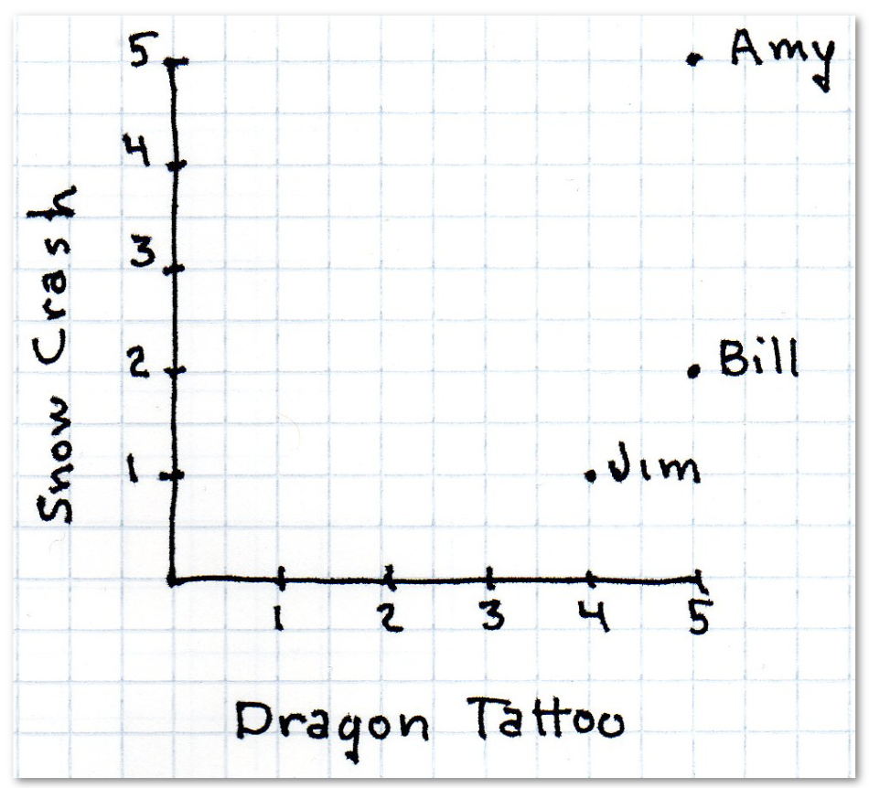
How do I find someone who is similar?

Slide 14
Manhattan Distance
| x1 - x2| + | y1 - y2 |

Slide 15
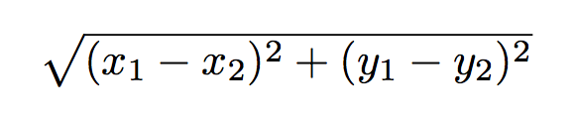
Euclidean Distance

Slide 17
N-dimensional

Slide 19
Exercise
Compute the Euclidean Distance between Hailey and Veronica.

Slide 20
A generalization
Minkowski Distance Metric
r = 1: The formula is Manhattan Distance.
r = 2: The formula is Euclidean Distance
r = ∞: Supremum Distance

Slide 21
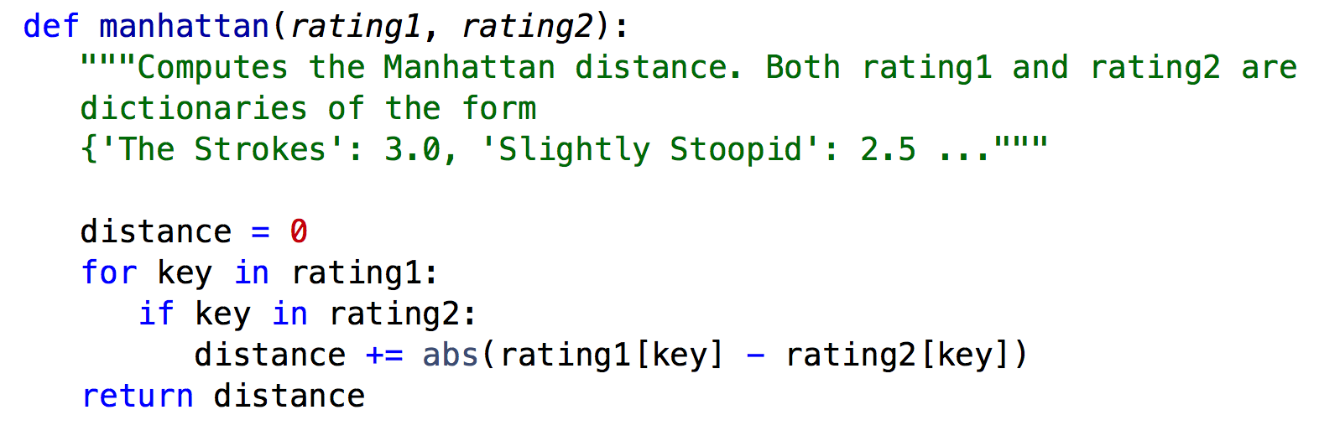
>>> manhattan(users['Hailey'], users['Veronica'])
2.0
>>> manhattan(users['Hailey'], users['Jordyn']) 7.5 >>>

Slide 22
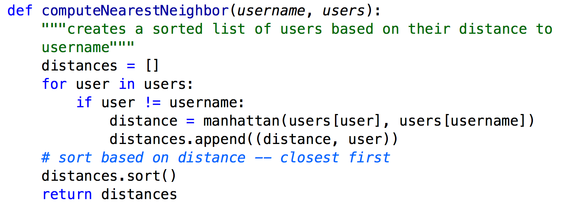
>>> computeNearestNeighbor("Hailey", users) [(2.0, ''Veronica'), (4.0, 'Chan'),(4.0, 'Sam'),
(4.5, 'Dan'), (5.0, 'Angelica'), (5.5, 'Bill'), (7.5, 'Jordyn')]

Slide 23
def recommend(username, users):
推薦給 username 的品牌，從 users 的購買行為中
和 username 最接近（相同喜好）的人中，找他有評分且 username 沒有評分的產品

Slide 24
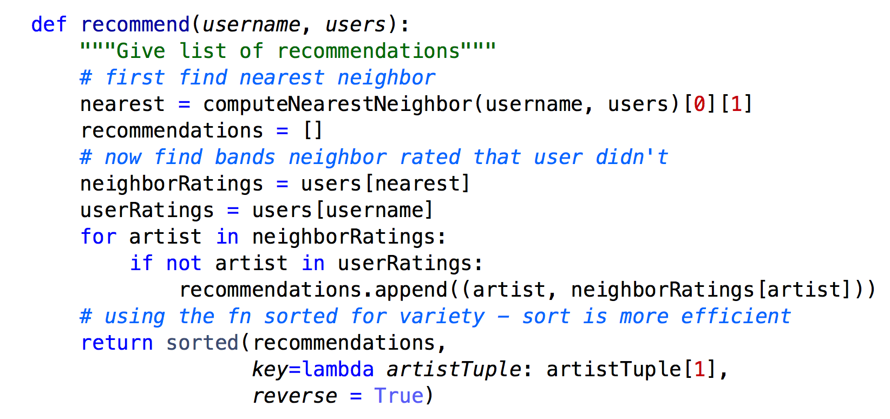
>>> recommend('Hailey', users) [('Phoenix', 4.0), ('Blues Traveler', 3.0), ('Slightly Stoopid', 2.5)]

Slide 25
Exercise
Implement the Minkowski Distance function.
Minkowski Distance Metric
r = 1: The formula is Manhattan Distance.
r = 2: The formula is Euclidean Distance
r = ∞: Supremum Distance

Slide 26
What is the problem?

Slide 27
Bill seems to avoid the extremes. His ratings range from 2 to 4
Jordyn seems to like everthing. Her ratings range from 4 to 5.
Hailey is a binary person giving either 1s or 4s to bands.

Slide 28
Pearson Correlation Coefficient
It ranges between -1 and 1 inclusive.
1 indicates perfect agreement.
-1 indicates perfect disagreement.

Slide 30
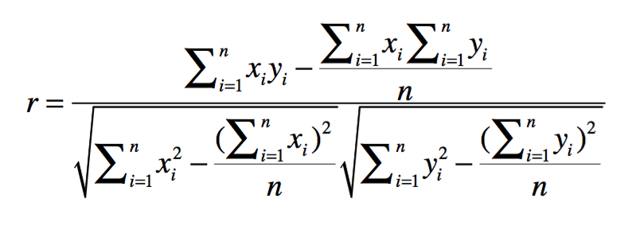
Approximation of Pearson

Slide 31
Exercise: implement the algorithm of approximation of Pearson
>>> pearson(users['Angelica'], users['Bill']) -0.90405349906826993
>>> pearson(users['Angelica'], users['Hailey']) 0.42008402520840293 >>> pearson(users['Angelica'], users['Jordyn']) 0.76397486054754316 >>>

Slide 32
def pearson(rating1, rating2):
sum_xy = 0
sum_x = 0 sum_y = 0 sum_x2 = 0 sum_y2 = 0 n=0
for key in rating1:
if key in rating2:
n += 1
x = rating1[key]
y = rating2[key]
sum_xy += x * y
sum_x += x
sum_y += y
sum_x2 += x**2
sum_y2 += y**2
# if no ratings in common return 0
if n == 0:
return 0
# now compute denominator
denominator = sqrt(sum_x2 - (sum_x**2) / n) *
sqrt(sum_y2 - (sum_y**2) / n)
if denominator == 0:
return 0
else:
return (sum_xy - (sum_x * sum_y) / n) / denominator

Slide 33
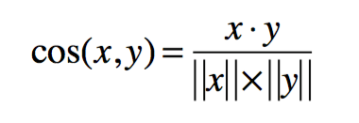
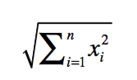
Cosine Similarity
Used when the data is sparse

Slide 34
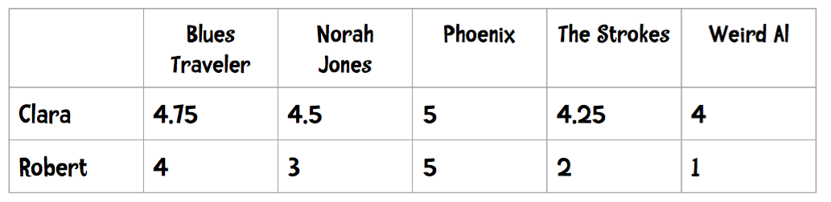
Example

Slide 35
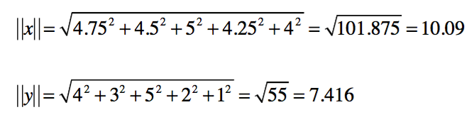
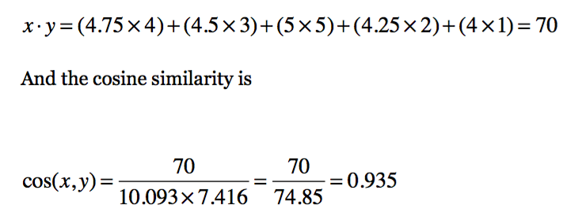
x = (4.75,4.5,5,4.25,4)
y = (4,3,5,2,1)

Slide 36
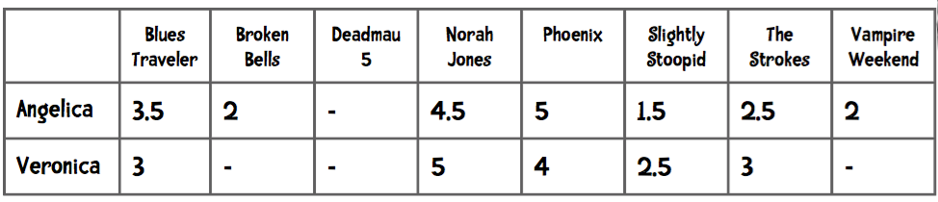
Exercise
Compute the Cosine Similarity between Angelica and Veronica (from our
dataset). (Consider dashes equal to zero)

Slide 37
Which similarity measure to use
If the data is subject to grade-inflation (different users may be using different scales), use Pearson.
If your data is dense (almost all attributes have non-zero values) and the magnitude of the attribute values is important, use distance measures such as Euclidean or Manhattan.
If the data is sparse consider using Cosine Similarity.

Slide 38
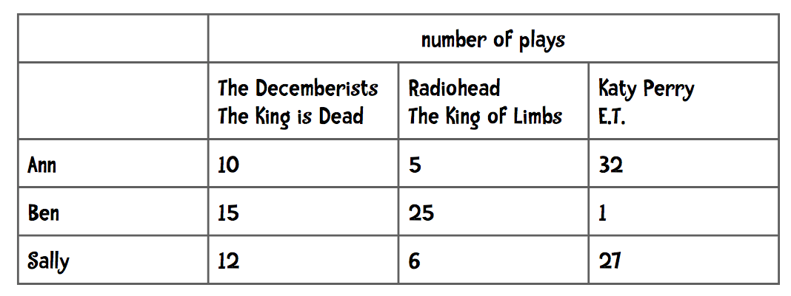
What is the problem?

Slide 39
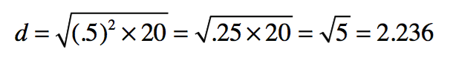
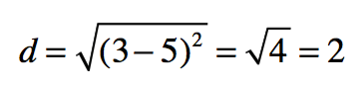
Eric and Linda
20 common in common and difference in their ratings of those 20 songs (on a scale of 1 to 5) averages only 0.5!!
Manhattan Distance: 20 x .5 = 10
Euclidean Distance would be:
Linda and Jake
Only one song in common, Linda: 3, Jake: 5
Manhattan: 2
Euclidean:
Linda and Jake are more similar!?

Slide 40
Implicit ratings and item based filting

Slide 41
For implicit ratings, we don't ask users to give any ratings—we just observe their behavior.
After observing what a user clicks on for a few weeks you can imagine that we could develop a reasonable profile of that user—she doesn't like sports but seems to like technology news.
Another implicit rating is what the customer actually buys. Amazon also keeps track of this information and uses it for their recommendations “Frequently Bought Together” and “Customers Who Viewed This Item Also Bought”:

Slide 42
Problems with explicit ratings
Problem 1: People are lazy and don't rate items.
Problem 2: People may lie or give only partial information.
Problem 3: People don't update their ratings.

Slide 43
Implicit data
Web pages:
clicking on the link to a page
time spent looking at a page
repeated visits
referring a page to others
what a person watches on Hulu
Music players:
what the person plays
skipping tunes
number of times a tune is played

